Slide 1
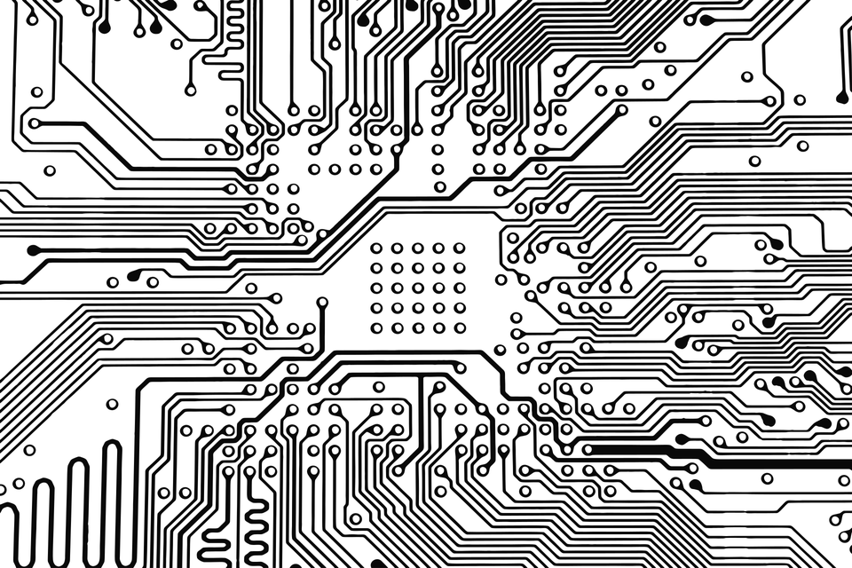
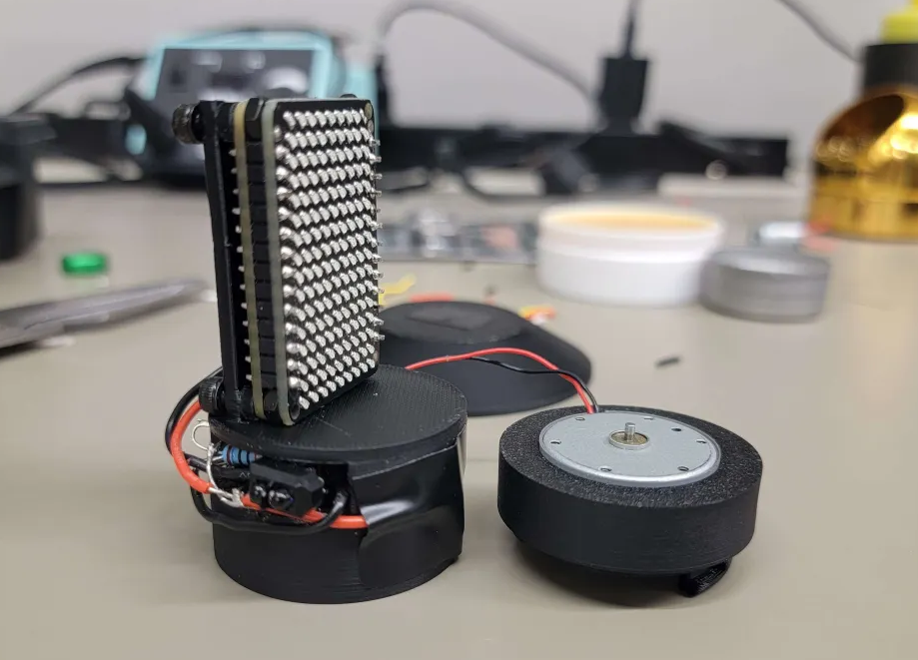

Intel
Engineers
ECE 3992
Semrah Odobasic, Logan Allen, Jin Jeong

Slide 2
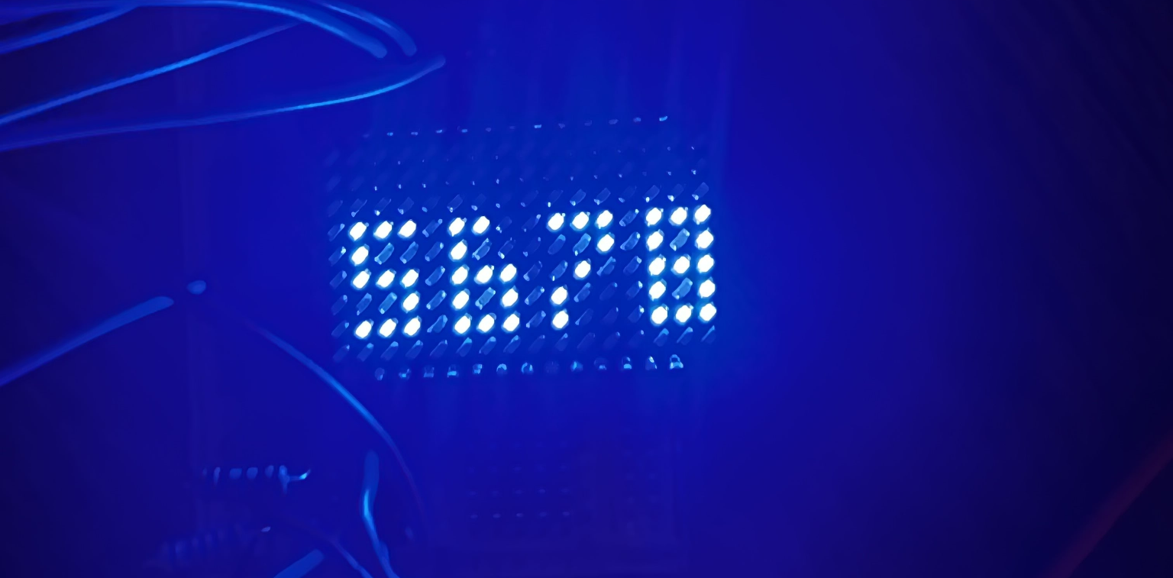
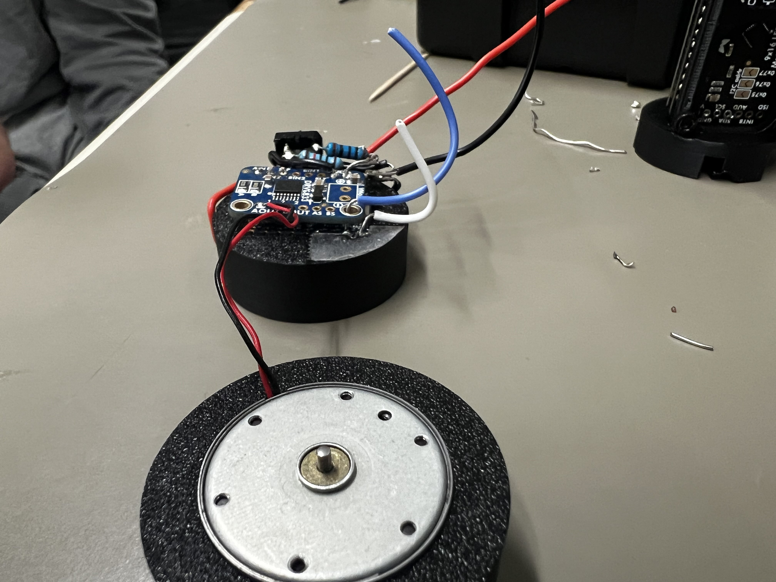
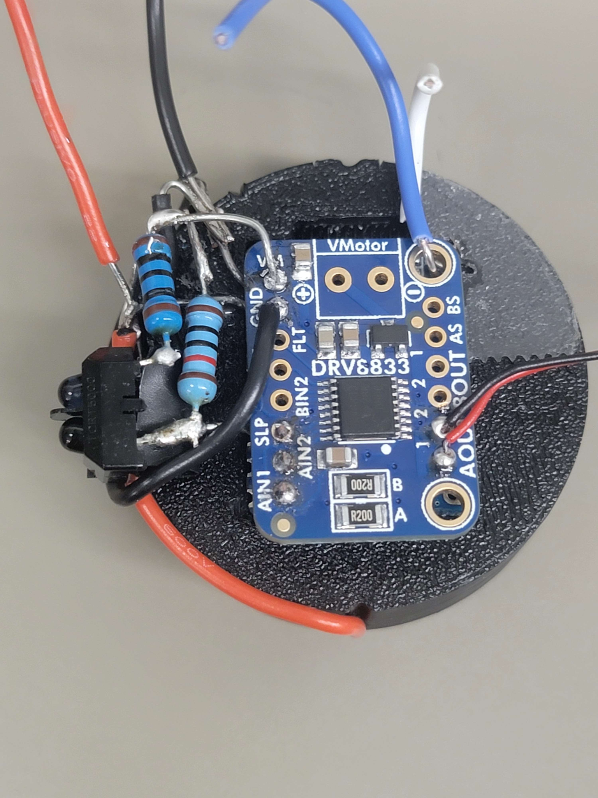
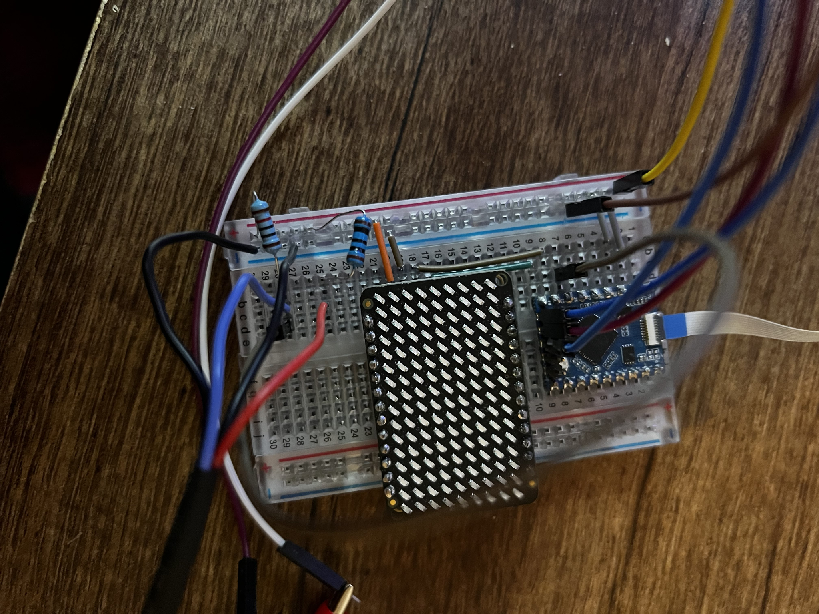
Agenda
The Project
Overview of the entire project
Risk Assessment & Progress
LED Matrix Library
Blender Data
Display 3D Data on Matrix
Assembly of Prototype
Future Plans / Stretch Goals
Different Technologies
Augmentations to Current Design

Slide 3
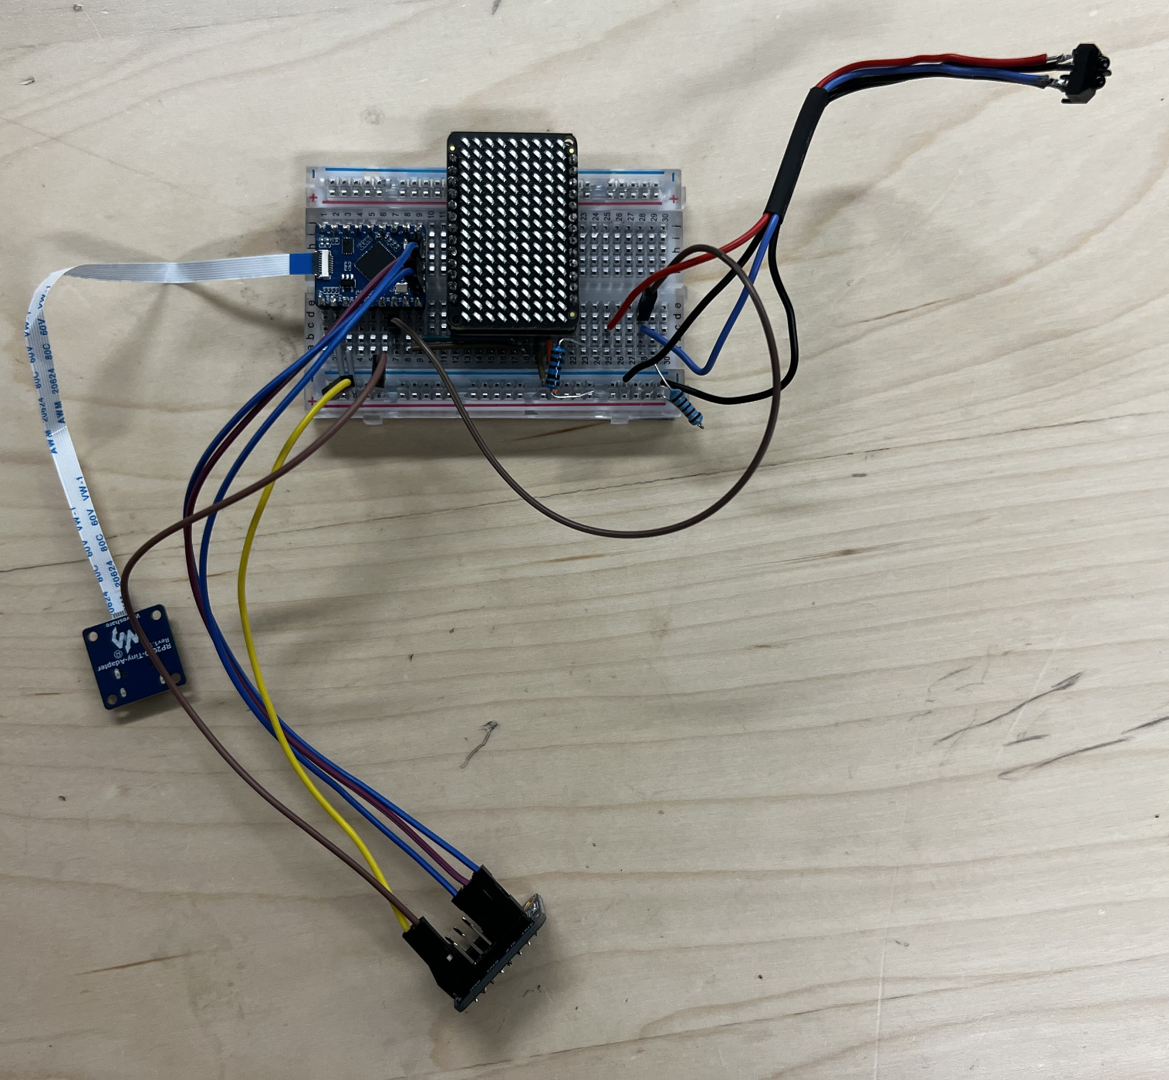
The Project
Volumetric 3D Display
Microcontroller
LED Display
Motor
Motor Driver
IR Sensor
Battery
Blender Data
24 2D Frames per 3D Frame
Displayed based on RPM

Slide 4
Convert display library to C High Risk [Completed]
AdaFruit IS31FL3731
Python Library
Inexperience with Python
Dislike of the Python IDE/toolchain
C++ Library
Involves Two Languages
Cross Compilation Required
Our C Library
Formatted for the Raspberry Pi Pico
Integrates Pico I2C with the Display Library

Slide 5

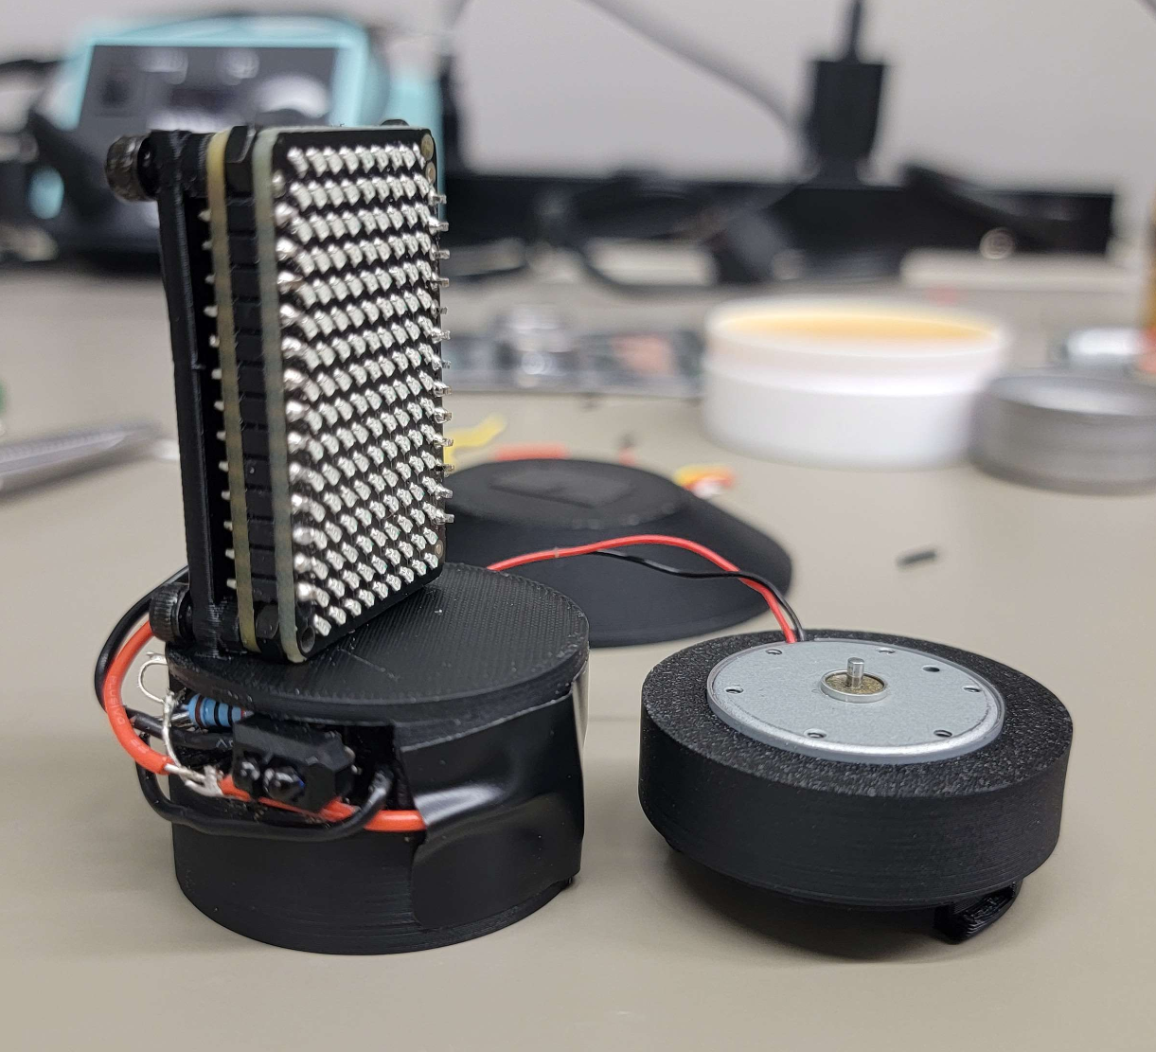
Motor Control Low Risk [Complete]
Motor Control via Motor Driver Board
Ensures no limits are passed on the RP2040
Motor can go Different Directions and Different Speeds Depending on PWM
Uses More Space
Extra board required which is the same size as the RP2040
Two H-Bridges but we only use one

Slide 6
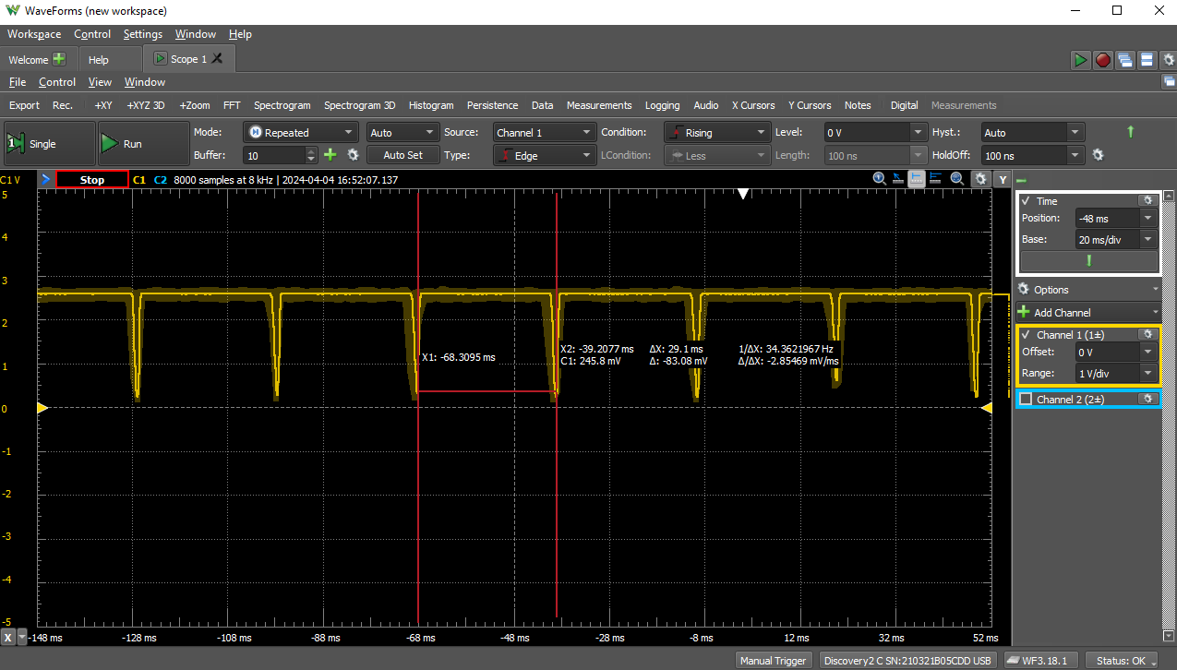
RPM Using IR Sensor Low Risk [Complete]
Ensures Display Switches Frames
Which makes sure the image is stationary
Display and IR sensing are done on two different cores to ensure they don't interfere with each other.
Falling Edge Detection
Interrupt is triggered on a falling edge
Interrupt counts the system time between the last call to determine the RPM

Slide 7
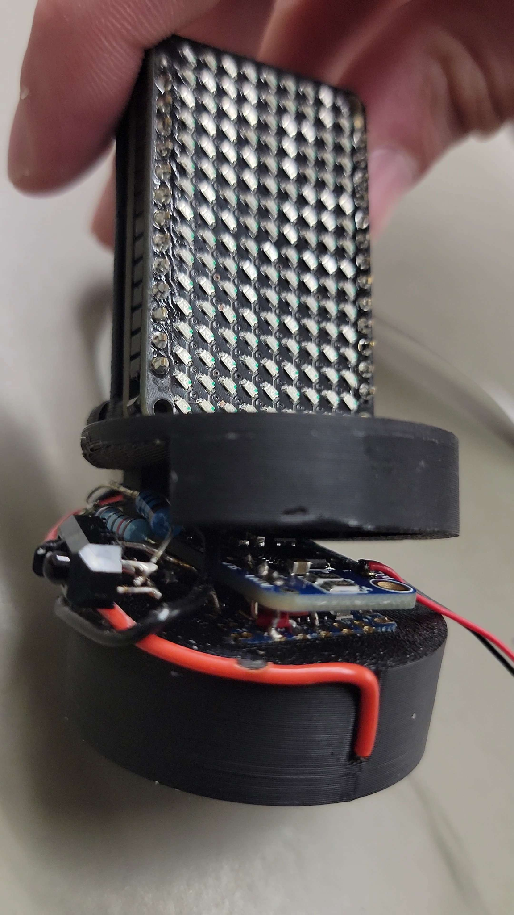
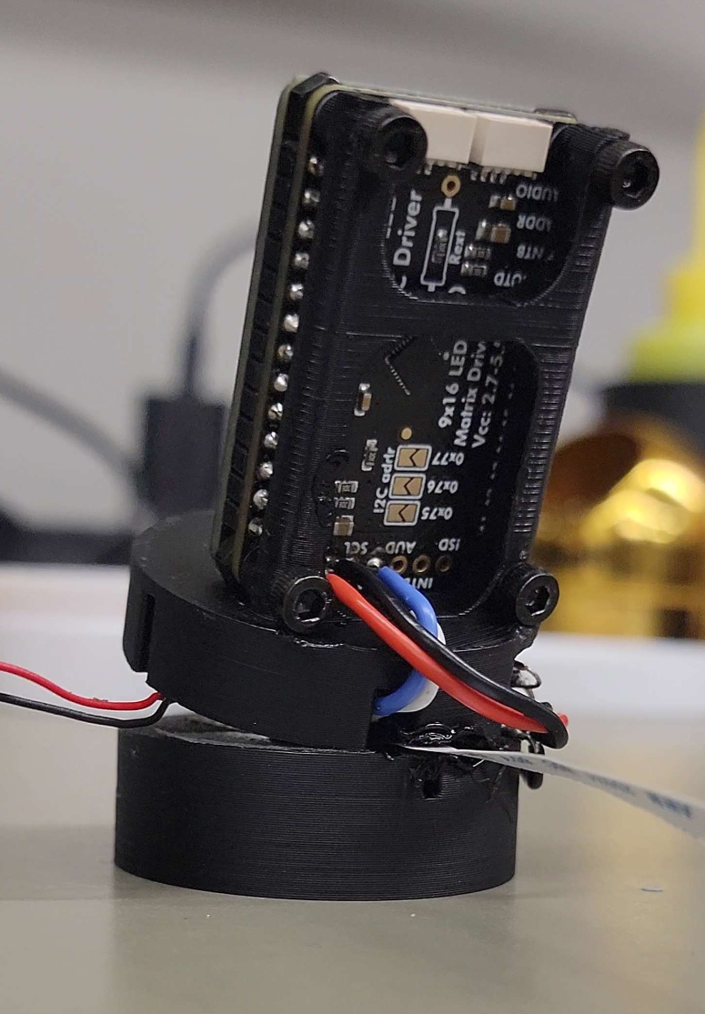
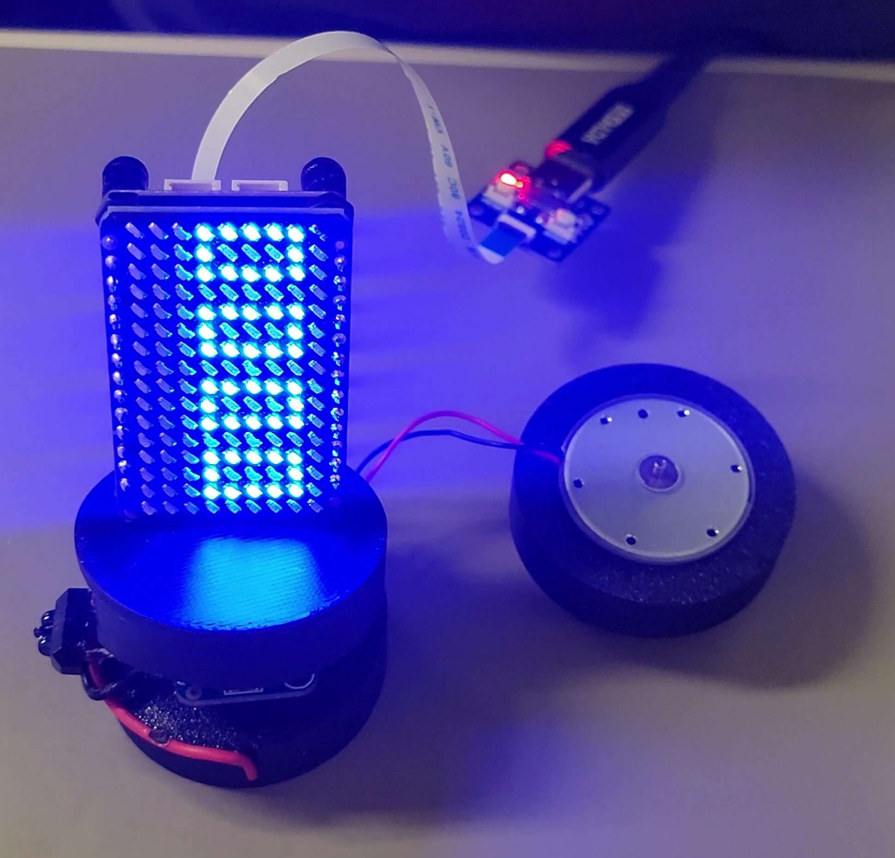
Combine Everything Into Volumetric Display Medium Risk [In-Progress]
Assembly
3D Printed Holder
Supports Matrix
Ensures Assembly Can Spin at High Speed
Interconnection of All Systems
We have Successfully Interconnected all Subsystems Together

Slide 8
Intel
Engineers
ECE 3992
Semrah Odobasic, Logan Allen, Jin Jeong

Slide 9
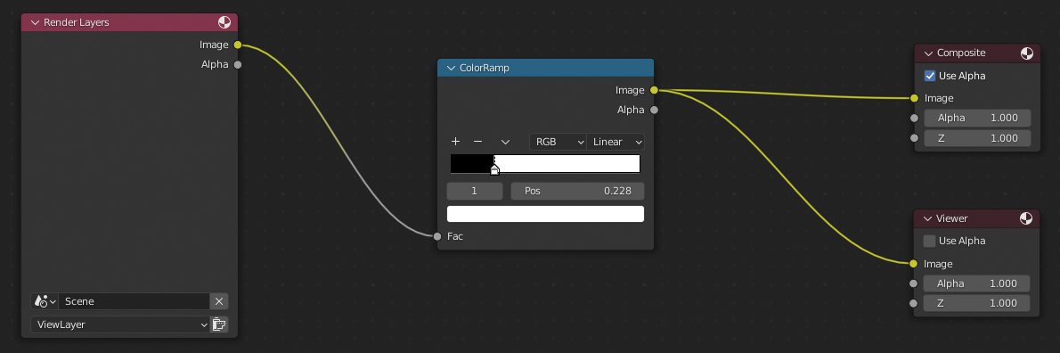

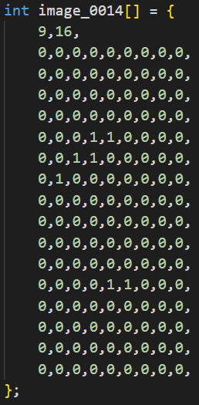
Extract 3D Data from Blender Medium Risk [Completed]
Blender Data Collection
Animate and Render Frames
Color Ramp Images for Pixels
16 x 9 Resolution
Image to C Array
Take in Blender Image
White Pixels = 1 Black Pixels = 0
Save Array to Pico
Consider Memory Limitations
24 2D Frames to Make 3D image
Animated 3D Frames
Very Manual Process

Slide 10
Display 3D Data to LED Matrix Medium Risk [In-Progress]
Update Animation Based on RPM
Matrix Switches Frames 24 Times a Rotation
Pico uses the IR sensor RPM to Change Speed
In Progress
Matrix switches based on RPM correctly
Current Image is not Fully Accurate
Most Likely from Rotation of Cube in Blender
Rework Blender Animation for an Easier Image

Slide 11
Future Plans | Stretch Goals
Different Style of Volumetric Display
Swept-Volume Display (Current)
Static Volumetric Display
No Moving Parts
LEDs preplaced in 3D Space
Lasers in a Gas
Augment Current Design
Bigger Display
Bigger Motor
RGB
Many More Possibilities
Still Need to Think About it

